Slide 1
Smart Bin
Technology used :
Android studio 1.3.2
WAMP server 2.5
Project by:
- Priti Parate
- Shilpa Chaudhary
- Pooja Rao
- Ananya Jana
- Priyadarshini G
Guided by– Amit Yadav (as we all were new to android and php)

Slide 2
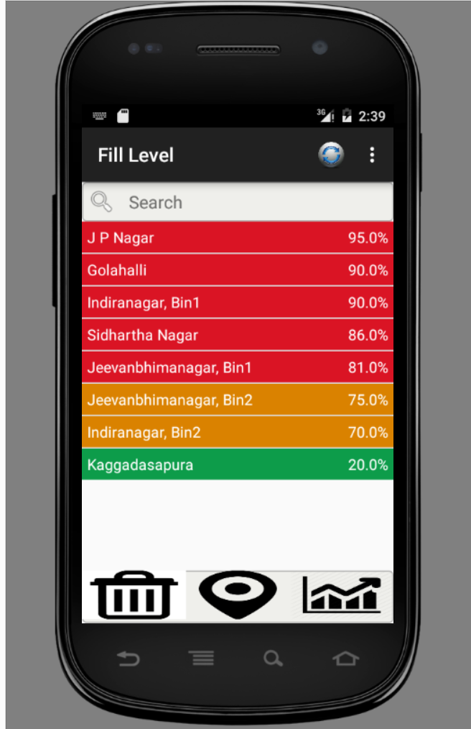
Fill level fragment
Refresh button help to refresh data based on current location
We can search data for any given location
Data has shown here based on current latitude and longitude. It is scrollable list view
Fill % 0-50 green
51-80 – orange
81-100 - red
Fill level, Map and analysis Icon
Note: sql query and script to
get all bins with given radius

Slide 3
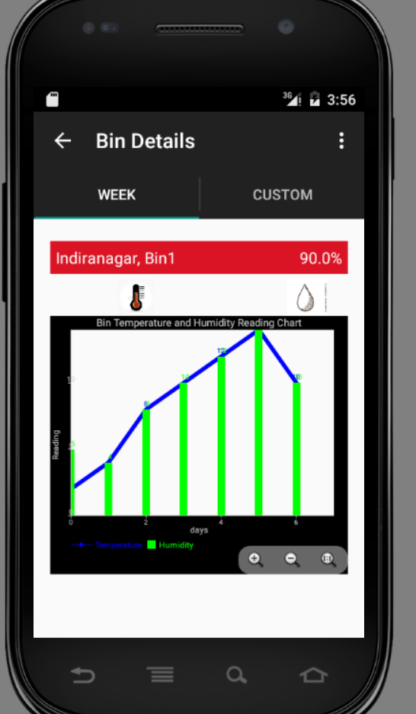
Bin details activity : after clicking on list item Week tab
Data of the last week
Script to get the data within given date range for any Bin Id

Slide 4
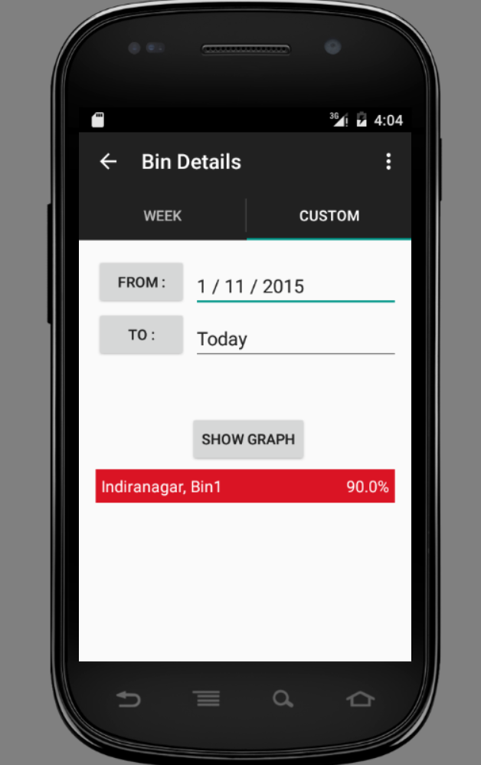
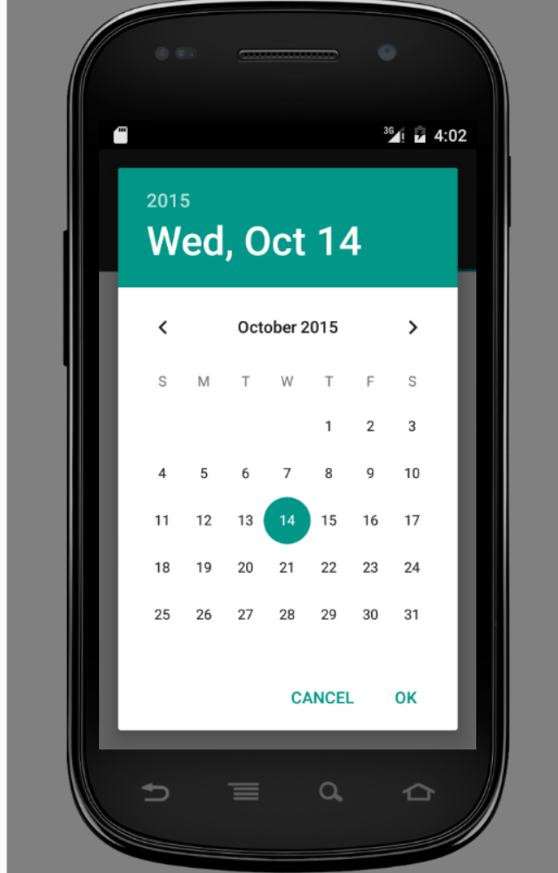
Custom tab with date picker

Slide 5
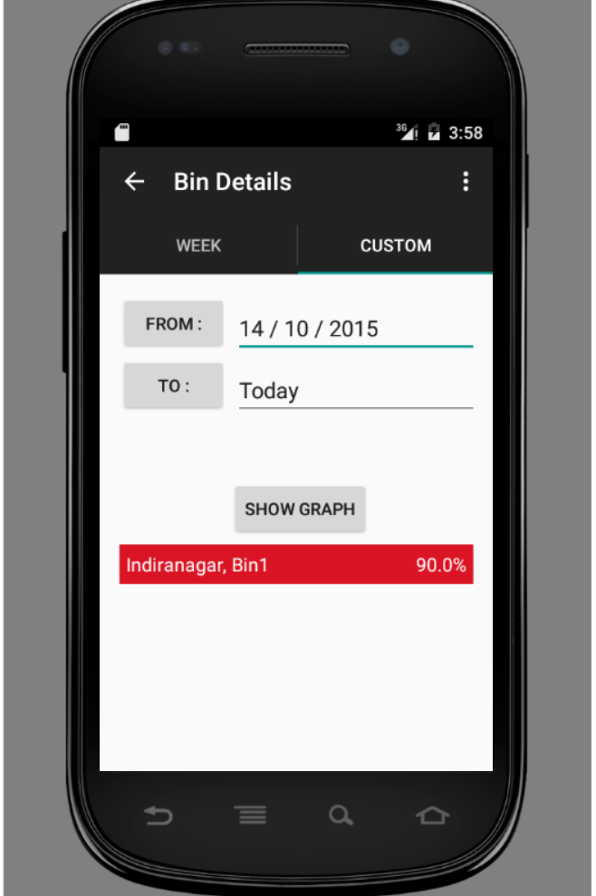
From date, restricted to last six months as currently database is restoring data for last six months
To date: by default set as “Today”
Button to give graph for selected range
On back pressed, it will take to fill level fragment

Slide 6
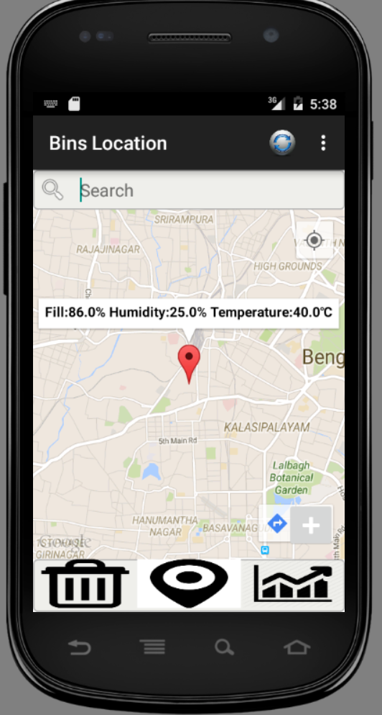
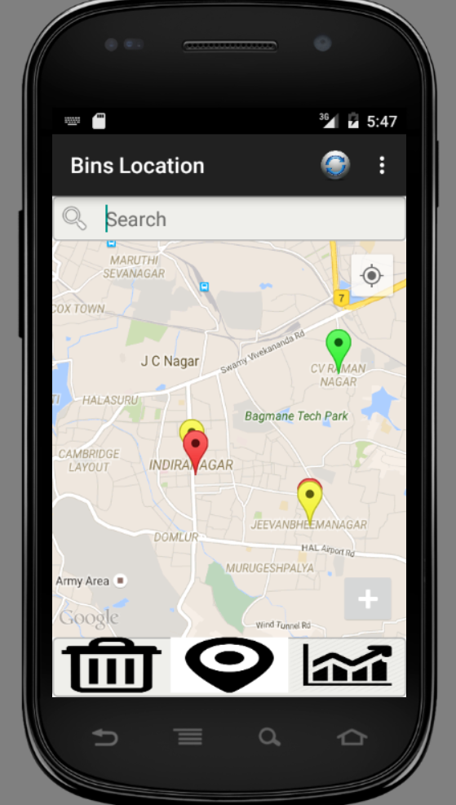
Mapped bin location which are in radius (radius set to 20km)
Note: After loading the fragments, idea is here to show markers only and not route as if some users are not interested to routes, and just want to see there locations on map, they can without waiting for route plotting
Button to get optimal routes for this pointes

Slide 7
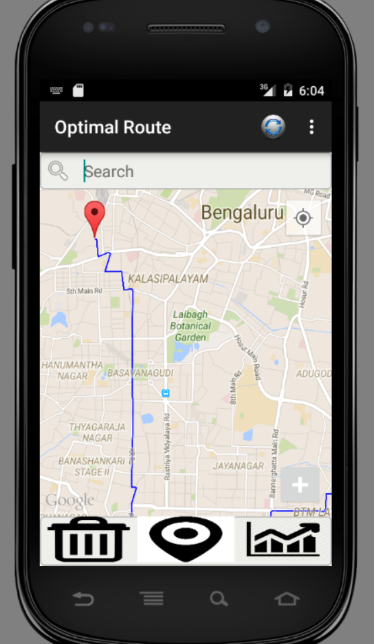
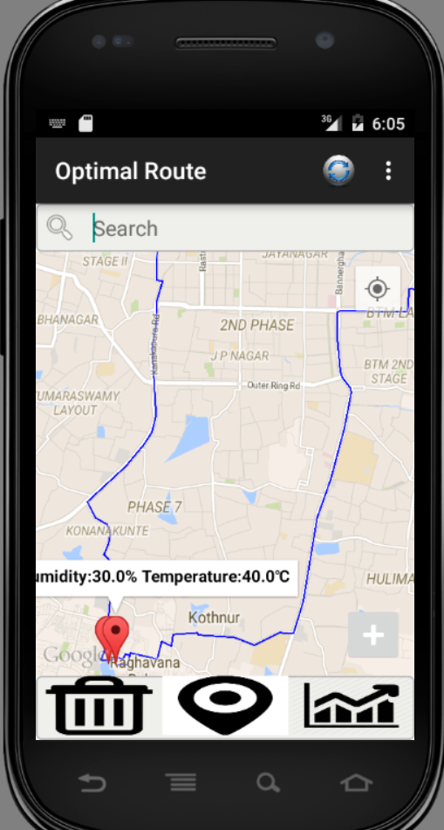
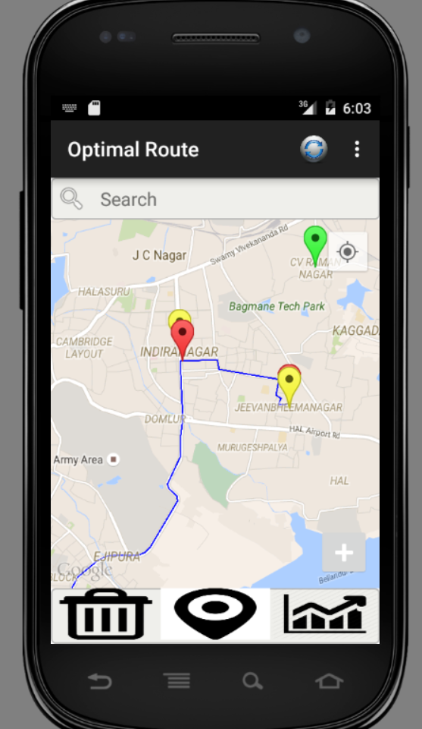
After clicking on optimal route button, it shows optimal route between all red colored markers. We have implemented traveling salesman problem using nearest neighbor mechanism, to get the optimal routes.
Optimal route button

Slide 8
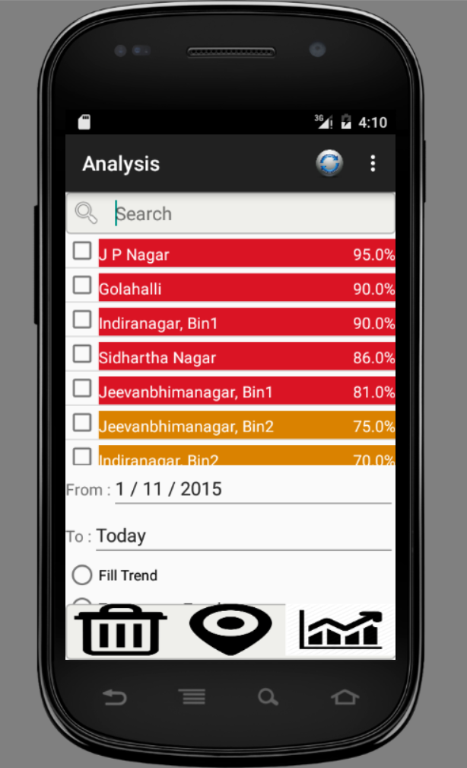
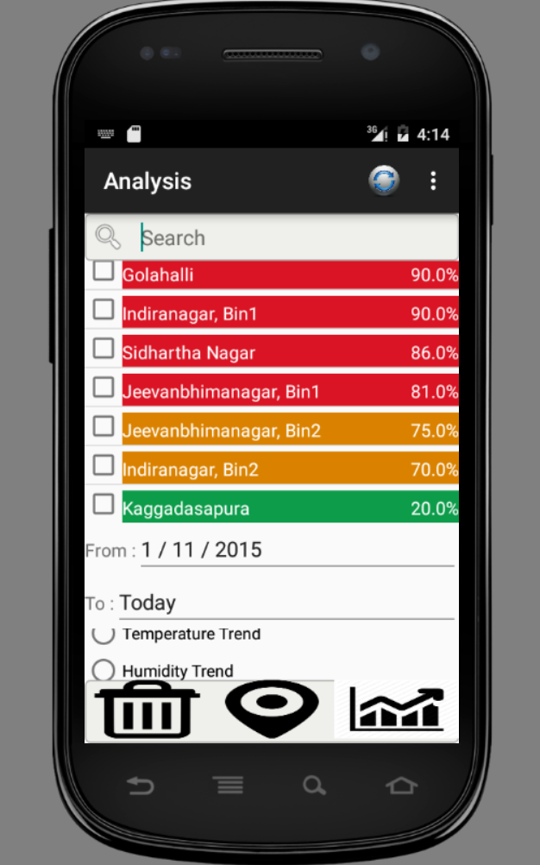
Analysis fragment
Scrollable list, Only two check box are allowed to check
Scrollable radio group

Slide 9
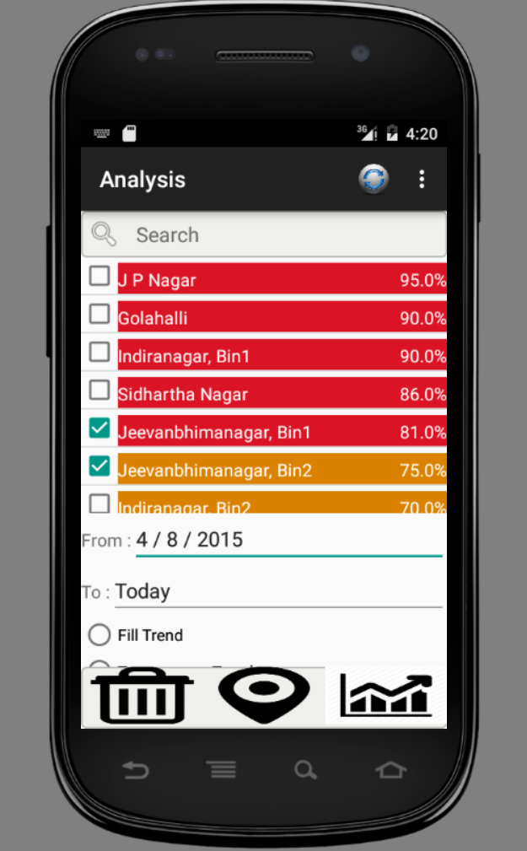
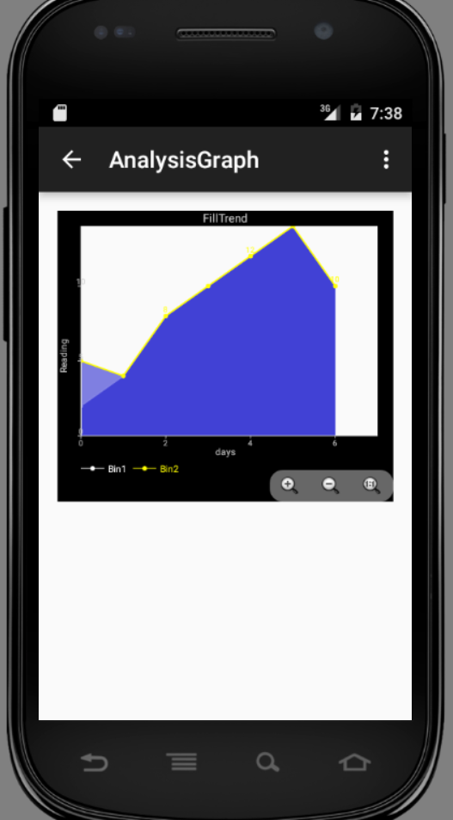
After Checkbox ,
And Date selection, by clicking on any radio button, can get the graph for selected range
Back button helps to go back to analysis fragment

Slide 10
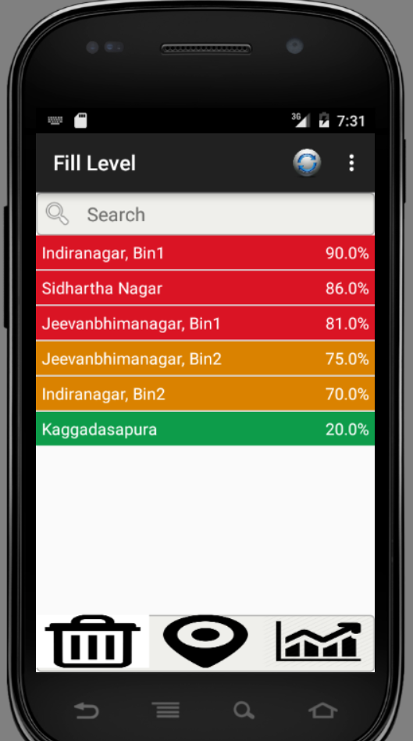
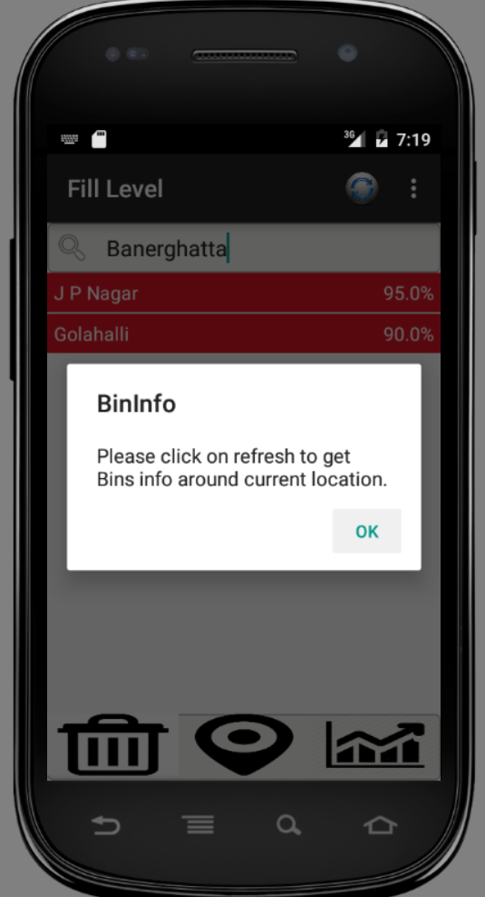
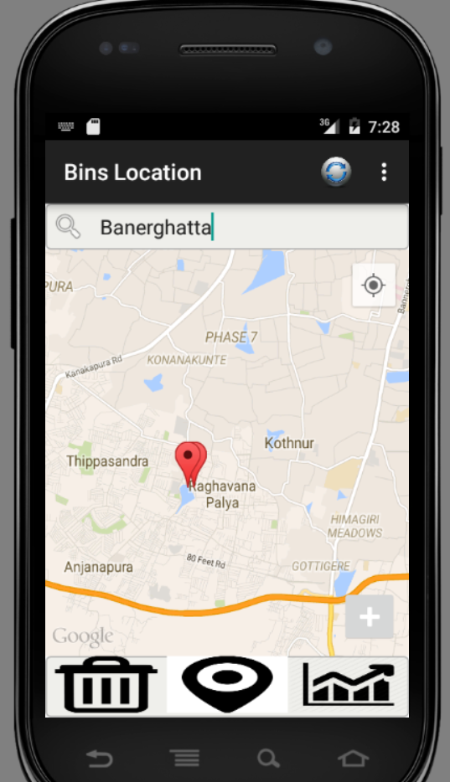
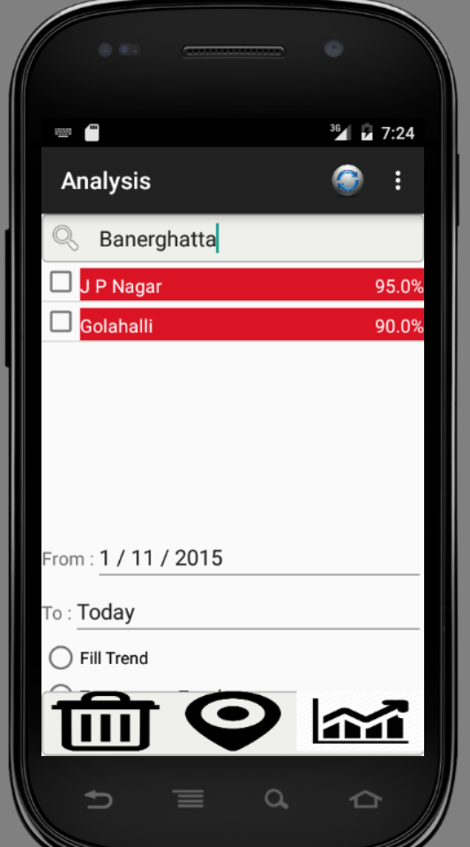
Search and refresh functionality :
In the search text box data can be search for any given area. Resultant data gets mapped to all fragment. Here no need to initiate same search query on each fragment. To get back all data related to current location, refresh button is provided
Note: Radius is set here as 10 km

